Slide 1
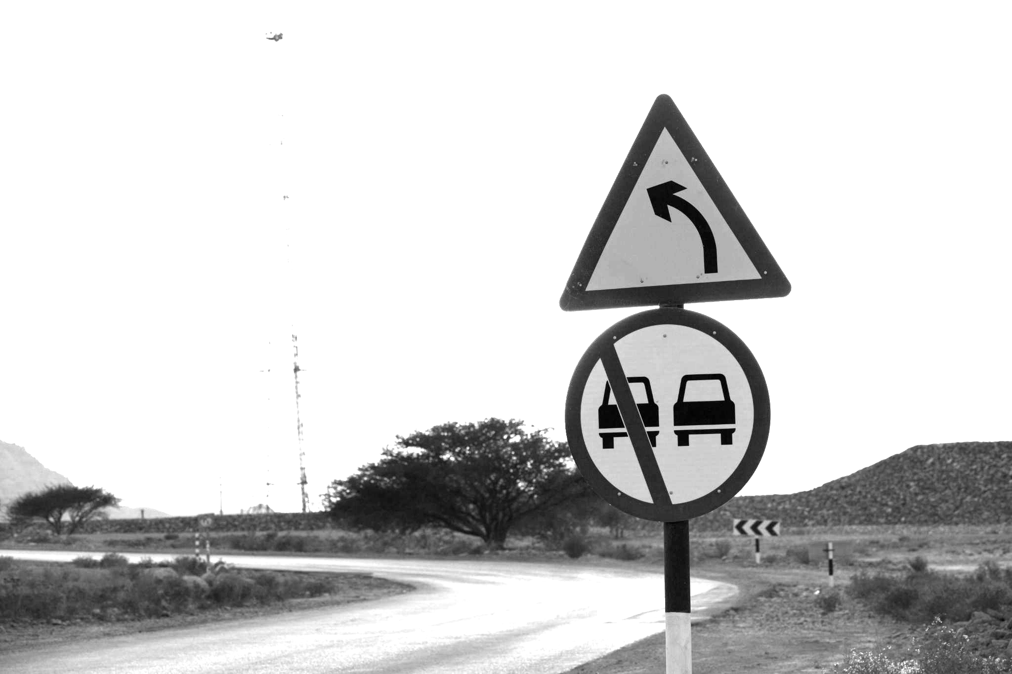
Traffic Sign Detection & Classification With Model Comparison
Shadman Sakib | 1813190642
Abdullah Al Talha | 1813193642
Md. Sharukh Fardin | 1821463042

Slide 2
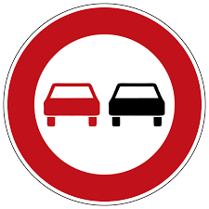

What is the project?
The purpose of our project is to detect and classify the roadside traffic signs. Drivers during driving or any person who is not aware of traffic signs in the road can easily use our system to determine the sign. For bad lighting, poor eyesight or lack of knowledge can be the reasons why traffic signs can be hard to detect by humans. Thats why, an automated system can be very helpful. We have used two different DL models and compared the performance: YOLO v5 and Faster Rcnn.

Slide 3

Analysis of the design principles
Variety of traffic signs (48 in our case)
The environment
The accuracy and speed requirements
The Dataset and quality of data
The models to use
The computational power
The complexities that may occurred

Slide 4
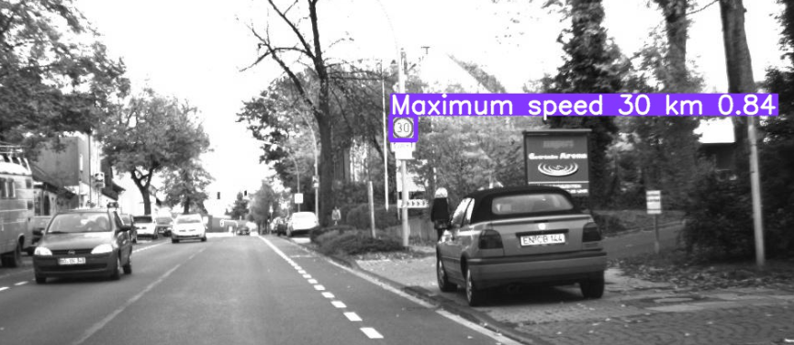
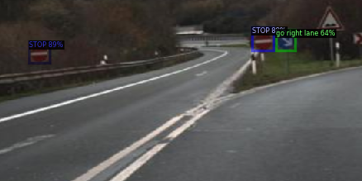
Implementation
YOLO v5 Faster Rcnn
YOLO V5
Faster-RCNN

Slide 5


Usability
Manufacturability
Death Reduction
Accuracy
Speed
Maintainability
Cost Efficiency
Extensibility

Slide 6

Environmental Considerations
Positive :
Road Safety Ensurement
Traffic Jam Improvement
Automated Cars
Negative :
Power And Storage Consumption
Impacts On Climate
Produce Electronic Wastes
Sustainability
Different lighting
Data Shortage

Slide 7
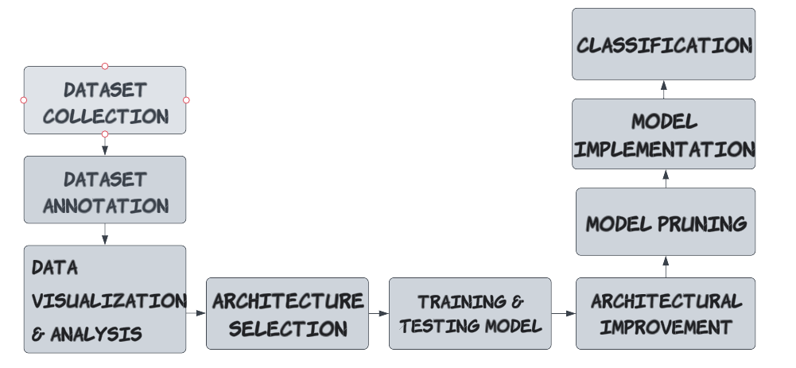
Development Process

Slide 8




TTools & Technologies Used
Roboflow: To annotate and label classes of our large dataset. We also pre-processed and augmented the dataset by using it.
Google Colab: To write our code for training and testing our models.
ClearML & Tensorboard: For the visualization of graphs and others.

Slide 9
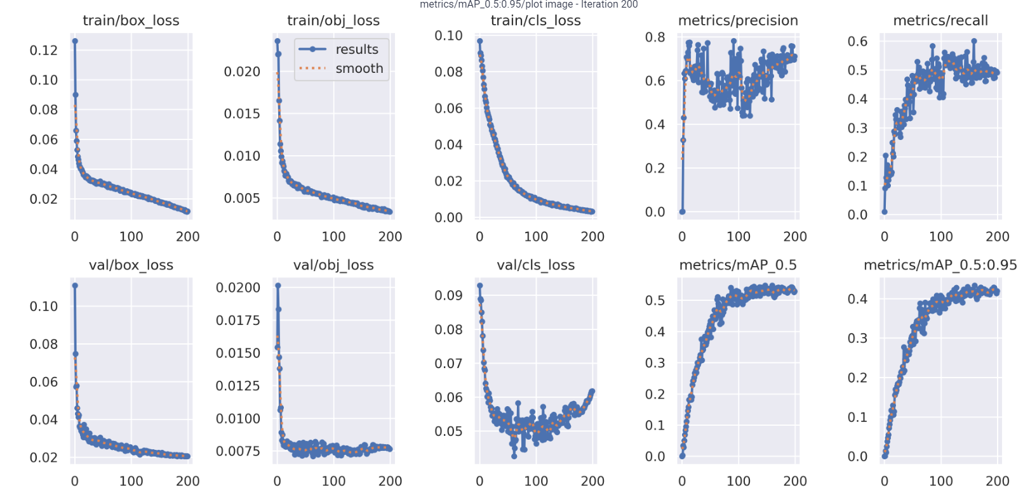
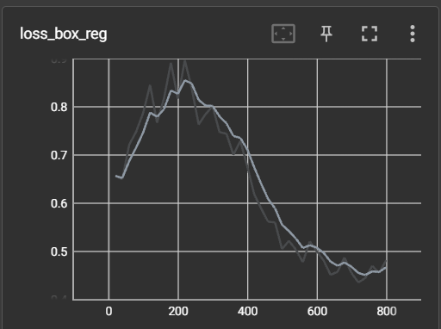
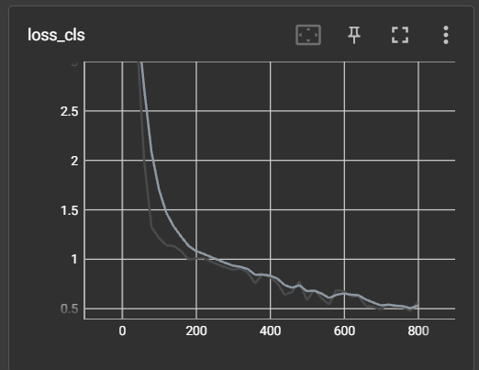
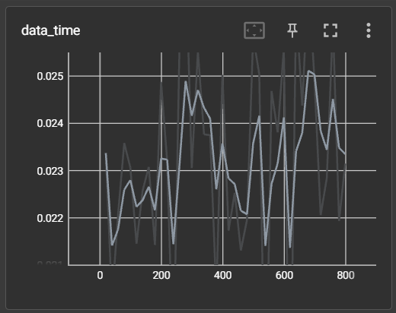
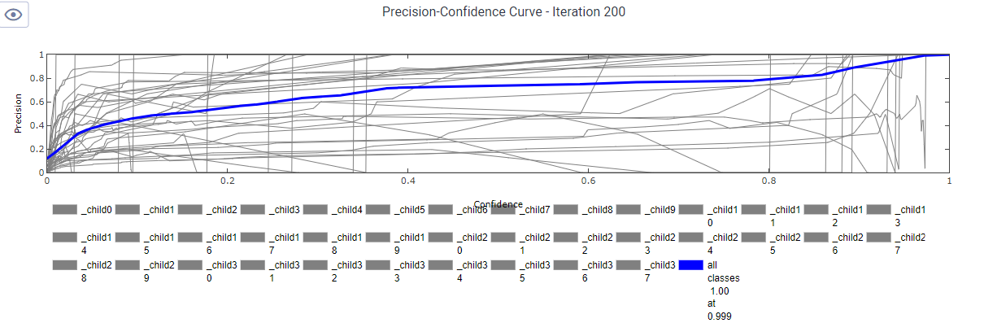
Yolov5 | Results | faster-RCNN

Slide 10
Thank You

